Slide 1
VIRTUAL REALITY
A real world review on somewhat touchy subject
SRINITHI K
DEEKSHA K
VISHALINI P
ABINESHWARAN A

Slide 2
THE BASICS
The core ideas are immersion and interactivity. Immersion means to block out distractions and focus selectively on just the information with which the participant wants to work.Interactivity means the ability for humans to interact with the events inthe virtual world. A virtual reality system should have three characteristics:
response to user actions,
real-time 3-D
graphics and a sense of immersion.

Slide 3
Virtual reality takes on various forms such as cab simulation, projected reality, augmented reality, telepresence and desktop virtual reality. Cab simula- tion is used for training airplane pilots. Projected reality uses projection technology to achieve a system that match-es the quality of workstation screens in terms of resolution, color and flicker-free stereo. In augmented reality, see-through Head-Mounted Displays (HMDs) superimpose virtual 3-D
objects on the real world. The outside world is visible along with the comput-er-generated graphics. With telepresence technology, manipulate objects in the virtual world, the results occur in a remote place of the real
world. Desktop virtual real-ity is a subset of tradi-tional virtual reality systems. It uses con-ventional, computer input and output ment, and data glove sensors, which measure the bend and flex of fingers capture the user’s actions and instruct the computer to generate new images and sound signals. The effectors, such as stereoscopic displays, stimulate the operator’s senses. The reality simulator links the sensors and effectors to produce sensory experiences that resemble those in the physical environment. The reality simulator continuously churns out sensor and effector information in order to keep the virtual illusion alive.
Latest develo Virtual reality has a wide range of uses from recreation to communication to scientific and medical research. Cur-rently, its situation is similar to the when users early-stages of computer graphics in the
1960s through the earlv devices such as a keyboard, mouse and monitor, instead of a head-mounted dis-play. Although the same level of spatial awareness is missing, it is a popular choice for business users due to the inadequacies of existing head-mounted

Slide 4
ARCHITECTURE
Virtual reality’s central objective is to place the participant in a virtual environment that gives the participant a feeling of “being there.” This requires linking the human perceptual and muscle systems with the“virtual environment.” A VR system consists of three types of hardware:
sensors,
2) effectors
3) the reality simulators
the sensors-such as head position sensors, which detect the operator’s body movement and data glove sensors, which measure the bend and flex of fingerscapture the user’s actions and instruct
the computer to generate new images and sound signals. The effectors, such as stereoscopic displays, stimulate theoperator’s senses. The reality simulator links the sensors and effectors to pro-
duce sensory experiences that resemble those in the physical environment. The reality simulator continuously churns out sensor and effector information in order to keep the virtual illusion alive.

Slide 5
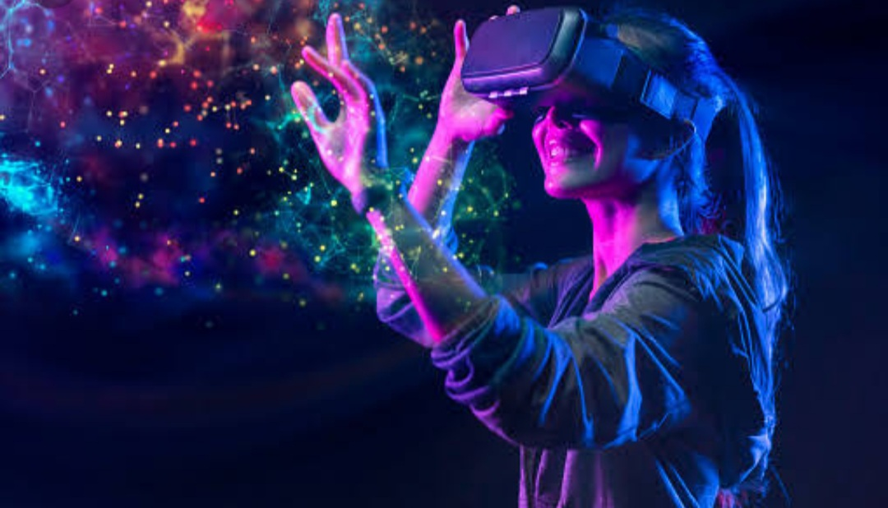
INNOVATIVE USES OF VIRTUAL REALITY
Dining
Now we can travel virtually to different places
and immerse ourselves in
certain environments while tasting
the dishes from these locations.

Slide 6
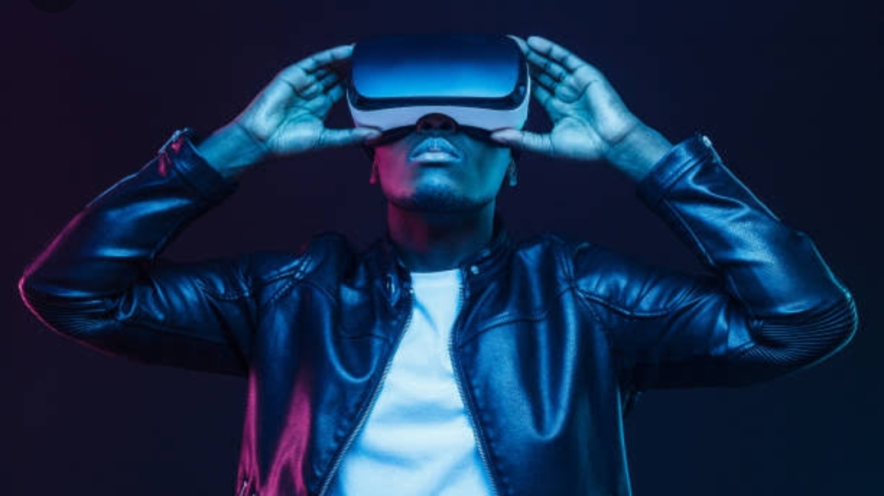
MEDICINE
The Spanish National Research
Council has succeeded in reducing
the effectsof Parkinson's in
several patients by applying a
treatment that uses VR.
EDUCATION
In classrooms, the use of VR
allows students to better retain
knowledge and helps students
with learning difficulties.

Slide 7
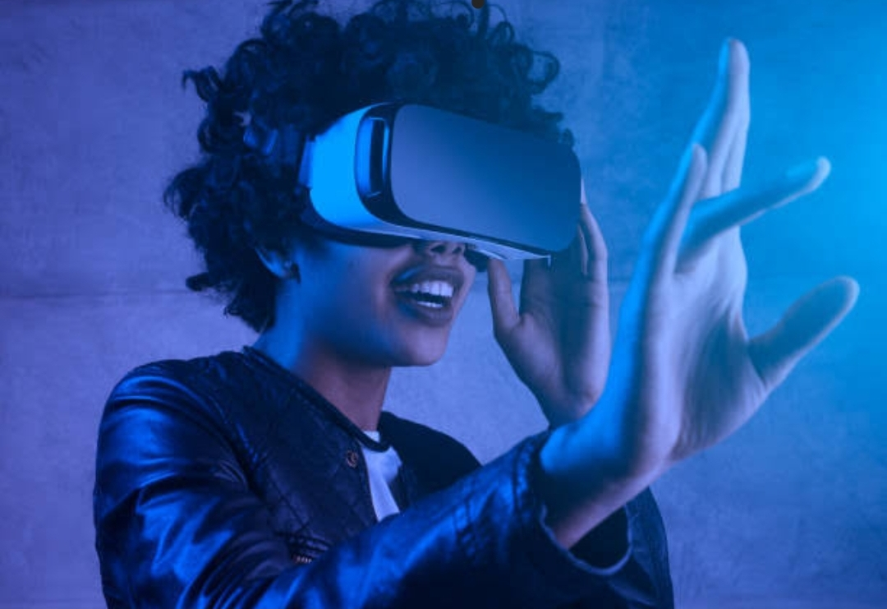
ENTERTAINMENT
Users can enter a scene in
a video game or practice
extreme sports without
moving from their sofa.
ARCHITECTURE
RV helps architects to better
envisage a space and present the project to their clients.

Slide 8
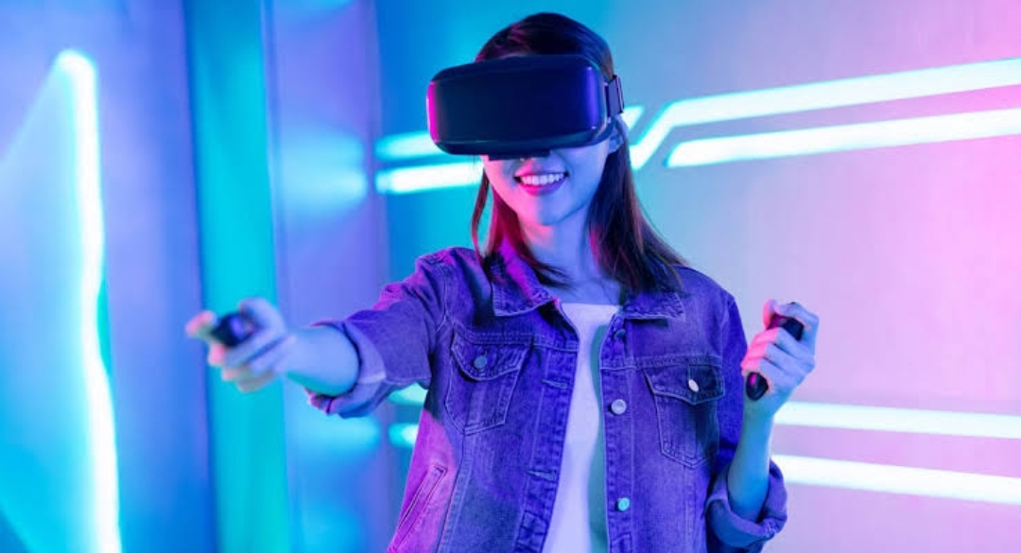
CULTURE/ART
INDUSTRY
Digital Twins are exact digital
copies of physical objects that
factory workers can practice
on and test in a virtual
world.
Some museums and galleries offer virtual
visits or immersive experiences to help
understand the history and culture
associated with each work.
MILITARY
The UK Ministry of Defence uses
VR for training in simulated
combat environments.

